Slide 1



ALGORITHMIC TRADING SYSTEM

Slide 2
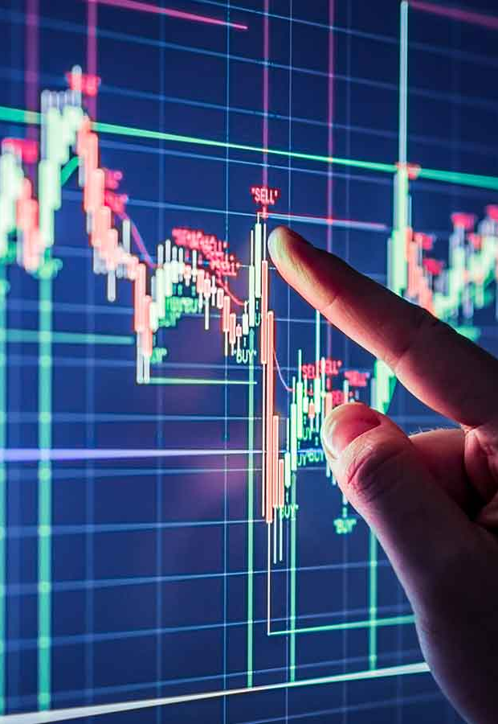
ALGORITHMIC TRADING SYSTEM
CLASS – 718 B
GROUP MEMBERS
Ayush Raj 20BCS7576
Lekhraj Sharma 20BCS7553
Shashwat Verma 20BCS7532
Shubham Kumar 20BCS7572

Slide 3
INTRODUCTION
"Amateurs think about how much money they can make. Professionals think about how much money they could lose."
Algorithm trading is all about the use of computers programs to automate one or more stages of the trading process: pre trade analysis (data analysis), trading signal generation (buy and sell recommendations), and trade execution. Today, Algorithmic trading is amongst the most talked about technologies in the recent years. It has given trading Firms more power in the rapidly evolving markets by eliminating human errors and changing the way financial markets are interlinked today. Its usage is credited to most markets and even to commodity trading.
These systems seek to capture fleeting anomalies in market prices, profit from statistical patterns within or across financial markets, optimally execute orders, disguise a trader's intentions, or detect and exploit rivals' strategies. Ultimately, profits drive any algorithmic trading system—whether in the form of cost savings, client commissions, or proprietary trading. Python has become a preferred choice for trading recently as Python is open-source and all the packages are free for commercial use. Python has gained traction in the quant finance community. Python makes it easy to build intricate statistical models with ease due to the availability of sufficient scientific libraries. Algorithmic trading and artificial stock markets have generated huge interest not only among brokers and traders in the financial markets but also across various disciplines in the academia. The emergence of algorithmic trading has created a new environment where the classic way of trading requires new approaches. In order to understand the impact of such a trading process on the functioning of the market, new tools, theories and approaches need to be created.

Slide 4

OBJECTIVES
Algo-trading is the fastest evolving technology with incredible and intelligent functionalities that improve trading performance and speed for market participants. Algo-trading constantly monitors markets and places orders when conditions match a set of parameters such as volume, price, resistance, support, or any other factor that the trader or market participant is comfortable with. One of the advantages of algo-trading is that by using available data, it can easily and quickly identify an ongoing trend.
The main objective of algo-trading is not just to profit by trading but to save costs, minimize market impact, and the execution risk of a trading order. Traders don’t need to watch stocks or send slices manually.
Algorithmic trading is mainly used by institutional investors and big brokerage houses to cut down on costs associated with trading. According to research, algorithmic trading is especially beneficial for large order sizes that may comprise as much as 10% of overall trading volume. Typically, market makers use algorithmic trades to create liquidity.
Algorithmic trading also allows for faster and easier execution of orders, making it attractive for exchanges. In turn, this means that traders and investors can quickly book profits off small changes in price. The scalping trading strategy commonly employs algorithms because it involves rapid buying and selling of securities at small price increments.
“The market is a device for transferring money from the impatient to the patient.”

Slide 5
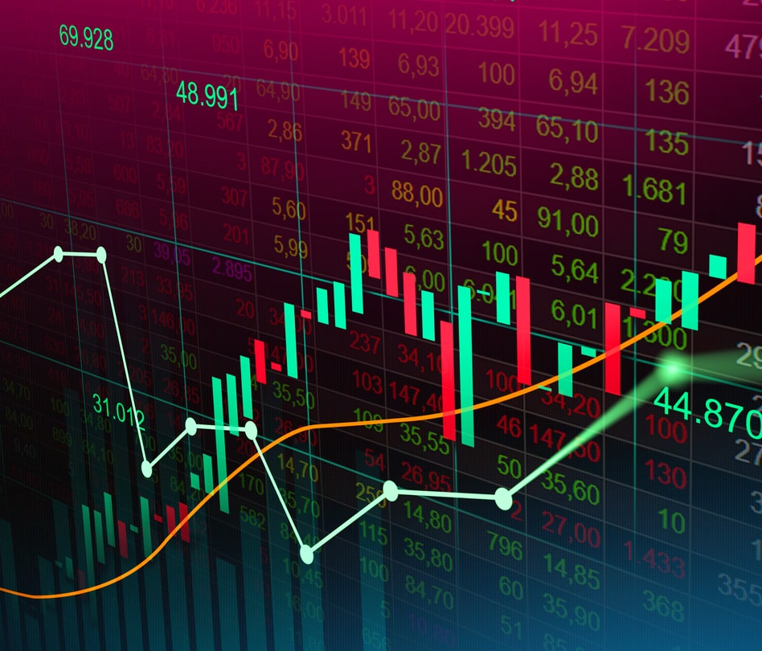
TECHNOLOGY USED
Python
FYERS API Bridge
Websocket
Selenium WebDriver
WebDriver Manager
Pandas
Ta-Lib
Flask

Slide 6
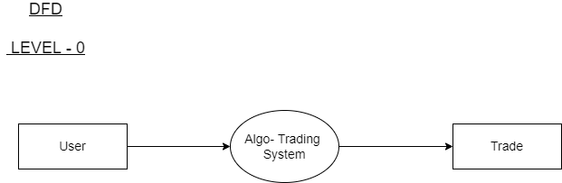
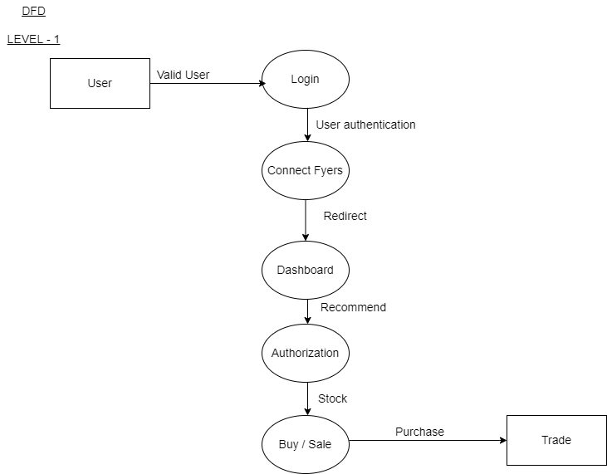
DESIGNS (Diagrams)
DFD ( LEVEL – 0 & LEVEL – 1 )

Slide 7
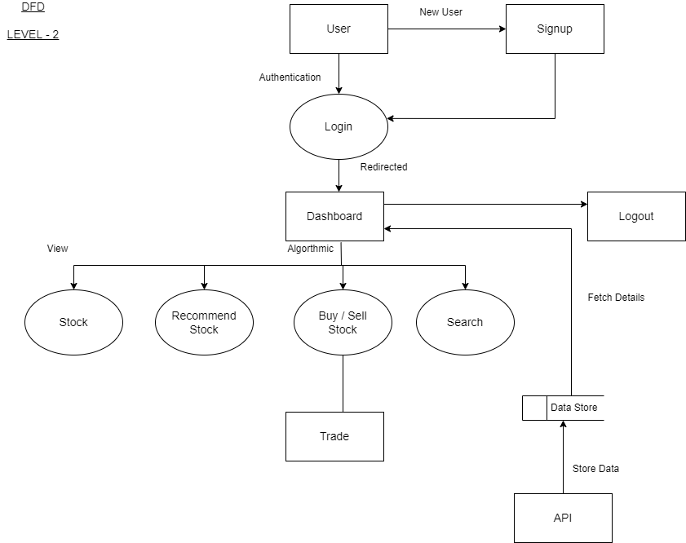

DESIGNS (Diagrams)
DFD ( LEVEL – 2 )

Slide 8
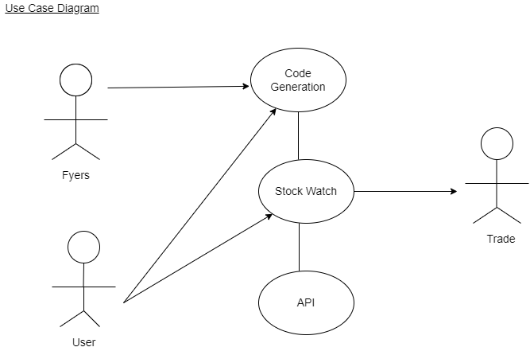
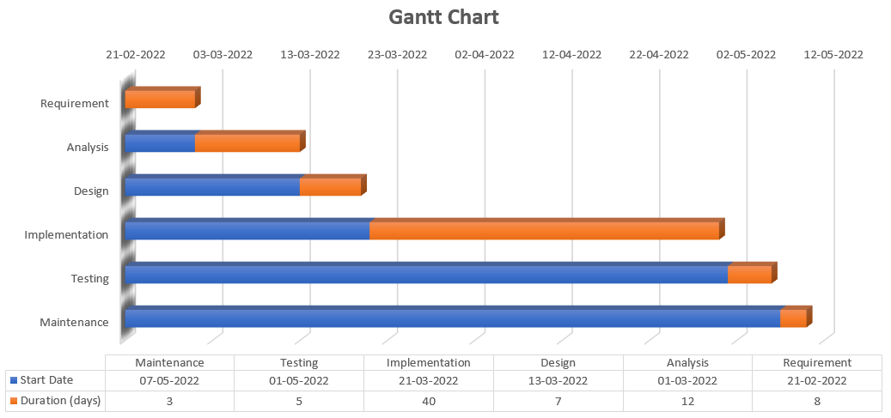
DESIGNS (Diagrams)
USE CASE DIAGRAM & GANTT CHART

Slide 9
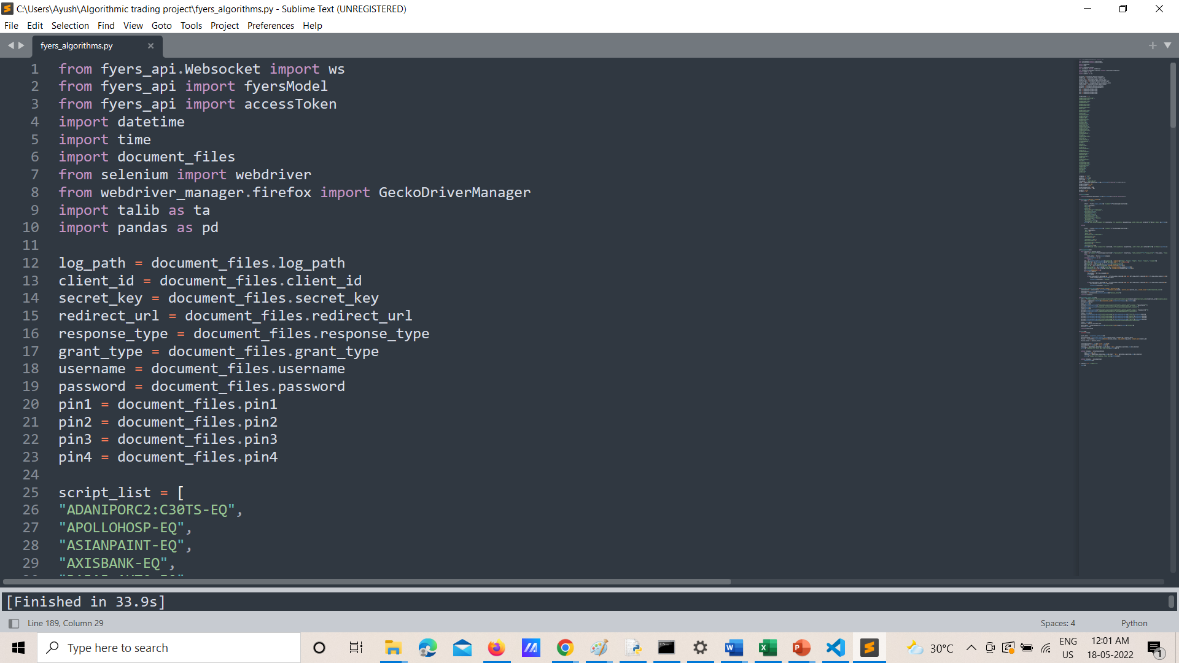
SCREENSHOTS

Slide 10
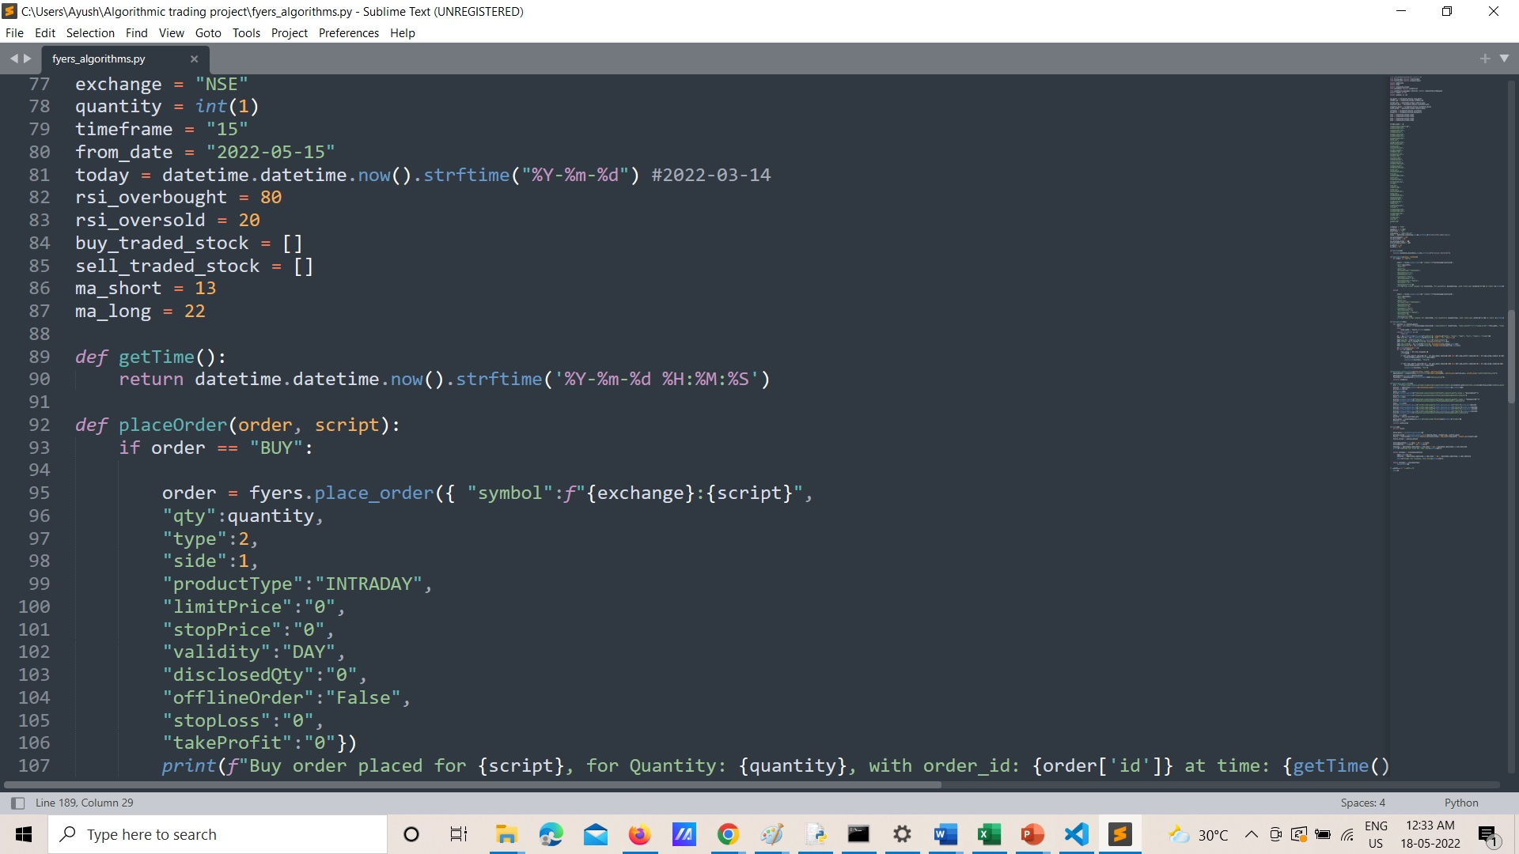
SCREENSHOTS

Slide 11
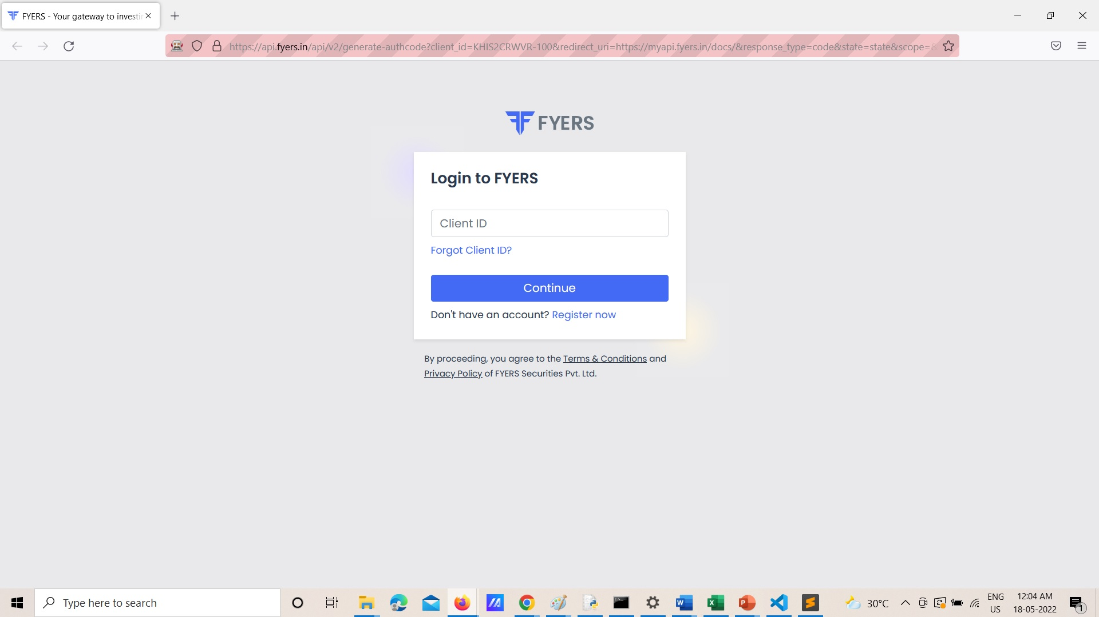
SCREENSHOTS

Slide 12
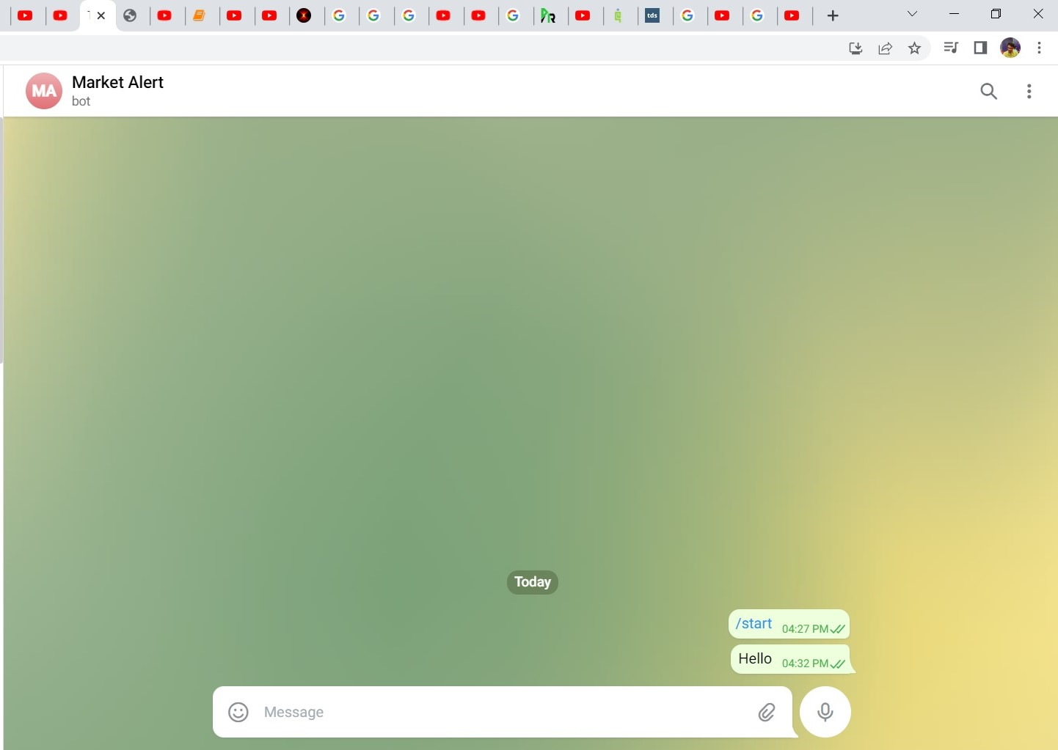
SCREENSHOTS

Slide 13
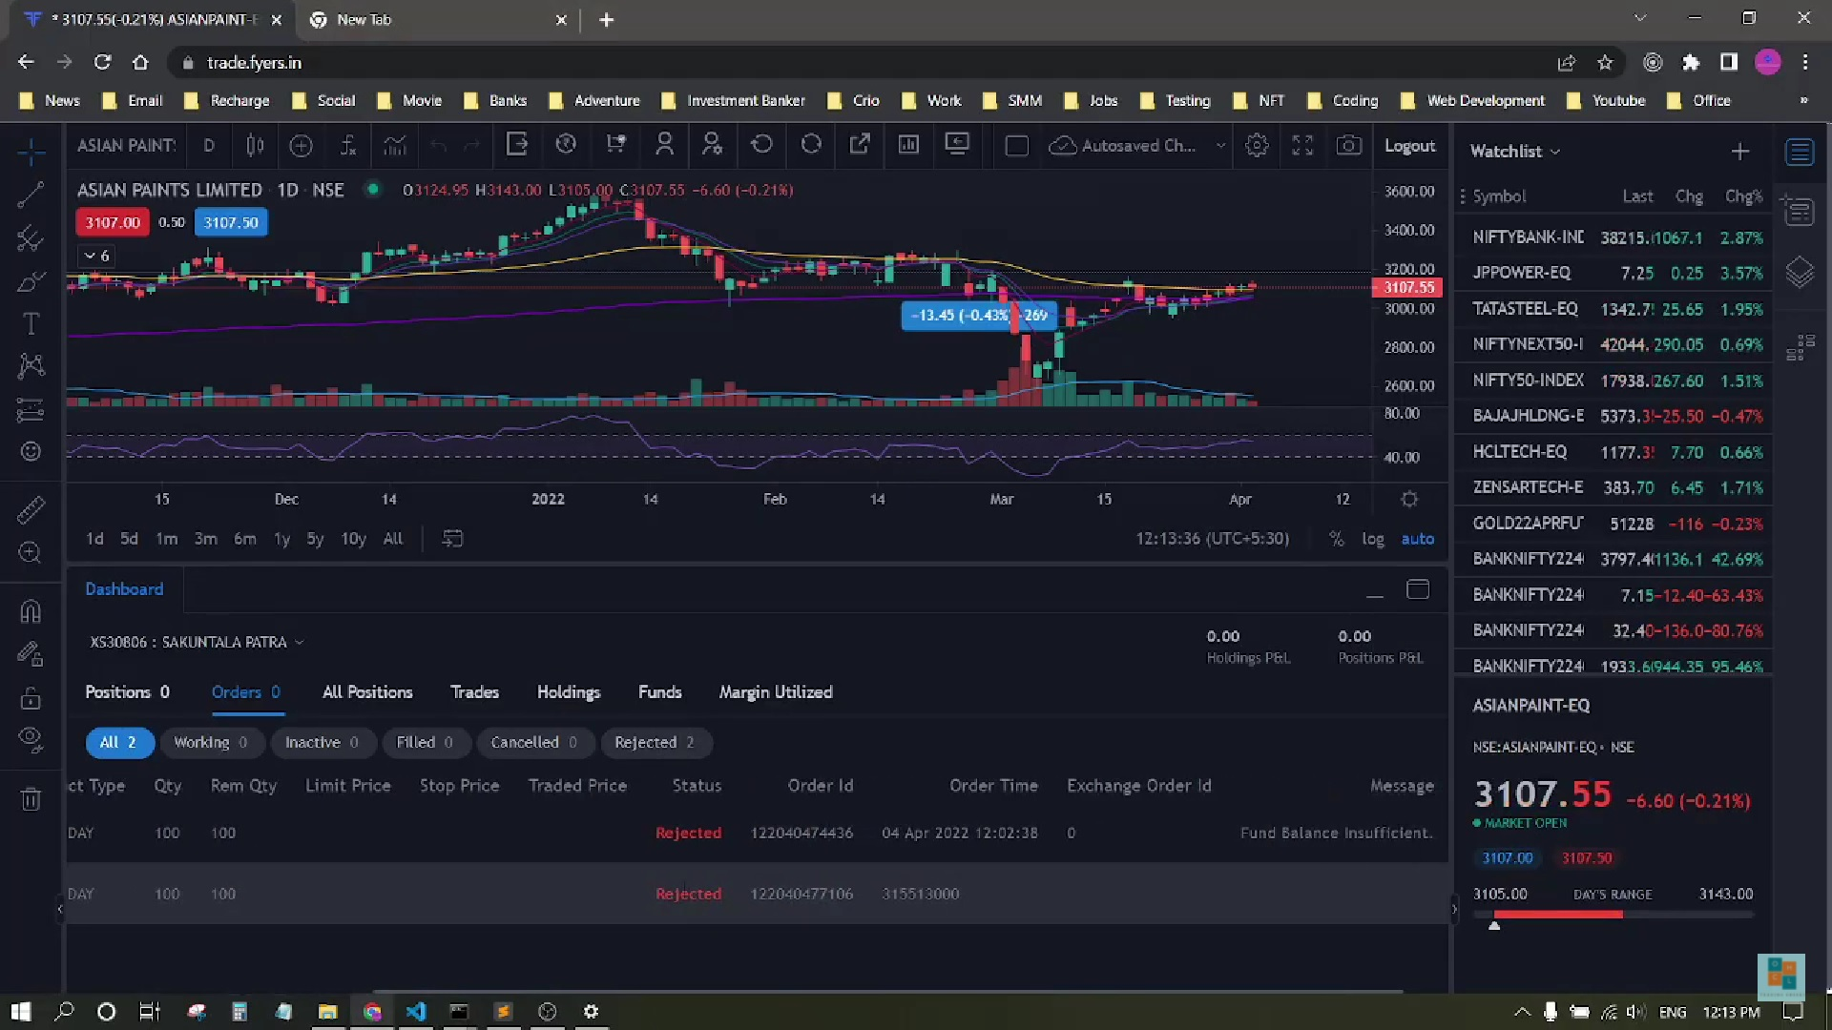
SCREENSHOTS

Slide 14
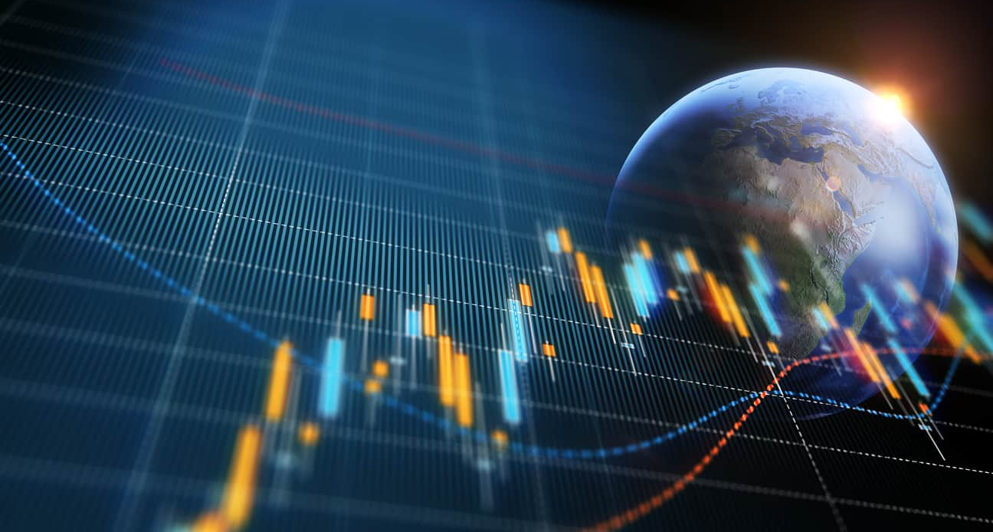
OUTCOMES
Algorithmic trading system is successfully created.
The system can buy and sell stocks based on the moving average and RSI strategy conveniently.
The telegram bot will be giving updates about the position of the stock and also it will update about the scanned stocks.
The login process in the FYERS dashboard was done automatically.
The algorithmic trading system was scheduled successfully so that it can run daily without human intervention.

